Slide 1
CSE245 – Algorithms
Single Source Shortest Path
(Dijkstra’s Algorithm)
Md. Shamsujjoha

Slide 2
Shortest Path Problems
What is shortest path ?
shortest length between two vertices for an unweighted graph:
smallest cost between two vertices for a weighted graph:
B
B
210
A
A
450
60
190
C
unweighted graph
C
weighted graph
200
130
D
D
E
E

Slide 3
Shortest Path Problems
How can we find the shortest route between two points on a map?
Model the problem as a graph problem:
Road map is a weighted graph:
vertices = cities
edges = road segments between cities
edge weights = road distances
Goal: find a shortest path between two vertices (cities)

Slide 4
Shortest Path Problems
Input:
Directed graph G = (V, E)
Weight function w : E → R
Weight of path p = ⟨v₀, v₁, . . . , v_{k}⟩
Shortest-path weight from u to v:
δ(u, v) = min w(p) : u v if there exists a path from u to v
∞ otherwise
Shortest path u to v is any path p such that w(p) = δ(u, v)
t
x
3
6
9
3
4
s
0
2
1
2
7
5
3
5
11
6
y
z
p

Slide 5
Variants of Shortest Paths
Single-source shortest path
G = (V, E) ⇒ find a shortest path from a given source vertex s to each vertex v ∈ V
Single-destination shortest path
Find a shortest path to a given destination vertex t from each vertex v
Reverse the direction of each edge ⇒ single-source
Single-pair shortest path
Find a shortest path from u to v for given vertices u and v
Solve the single-source problem
All-pairs shortest-paths
Find a shortest path from u to v for every pair of vertices u and v

Slide 6
Optimal Substructure of Shortest Paths
Given:
A weighted, directed graph G = (V, E)
A weight function w: E → R,
A shortest path p = ⟨v₁, v₂, . . . , v_{k}⟩ from v₁ to v_{k}
A subpath of p: p_{ij} = ⟨v_{i}, v_{i+1}, . . . , v_{j}⟩, with 1 ≤ i ≤ j ≤ k
Then: p_{ij} is a shortest path from v_{i} to v_{j}
Proof: p = v₁ v_{i} v_{j} v_{k}
w(p) = w(p_{1i}) + w(p_{ij}) + w(p_{jk})
Assume ∃ p_{ij}’ from v_{i} to v_{j} with w(p_{ij}’) < w(p_{ij})
⇒ w(p’) = w(p_{1i}) + w(p_{ij}’) + w(p_{jk}) < w(p) contradiction!
v_{j}
p_{ij}
p_{jk}
v₁
p_{1i}
p_{ij}’
v_{k}
v_{i}
p_{1i}
p_{ij}
p_{jk}

Slide 7
Shortest-Path Representation
For each vertex v ∈ V:
d[v] = δ(s, v): a shortest-path estimate
Initially, d[v]=∞
Reduces as algorithms progress
π[v] = predecessor of v on a shortest path from s
If no predecessor, π[v] = NIL
π induces a tree—shortest-path tree
Shortest paths & shortest path trees are not unique
t
x
3
6
9
3
4
s
0
2
1
2
7
5
3
5
11
6
y
z

Slide 8
Initialization
Alg.: INITIALIZE-SINGLE-SOURCE(V, s)
for each v ∈ V
do d[v] ← ∞
π[v] ← NIL
d[s] ← 0
All the shortest-paths algorithms start with INITIALIZE-SINGLE-SOURCE

Slide 9
Relaxation
Relaxing an edge (u, v) = testing whether we can improve the shortest path to v found so far by going through u
If d[v] > d[u] + w(u, v)
we can improve the shortest path to v
⇒ update d[v] and π[v]
s
s
u
v
u
v
After relaxation:
d[v] ≤ d[u] + w(u, v)
5
2
9
5
2
6
RELAX(u, v, w)
RELAX(u, v, w)
u
v
u
v
5
2
7
5
2
6

Slide 10
RELAX(u, v, w)
if d[v] > d[u] + w(u, v)
then d[v] ← d[u] + w(u, v)
π[v] ← u
All the single-source shortest-paths algorithms
start by calling INIT-SINGLE-SOURCE
then relax edges
The algorithms differ in the order and how many times they relax each edge

Slide 11
Dijkstra’s Algorithm
Single-source shortest path problem:
No negative-weight edges: w(u, v) > 0 ∀ (u, v) ∈ E
Maintains two sets of vertices:
S = vertices whose final shortest-path weights have already been determined
Q = vertices in V – S: min-priority queue
Keys in Q are estimates of shortest-path weights (d[v])
Repeatedly select a vertex u ∈ V – S, with the minimum shortest-path estimate d[v]

Slide 12
Dijkstra (G, w, s)
t
1
x
INITIALIZE-SINGLE-SOURCE(V, s)
S ← ∅
Q ← V[G]
while Q ≠ ∅
do u ← EXTRACT-MIN(Q)
S ← S ∪ {u}
for each vertex v ∈ Adj[u]
do RELAX(u, v, w)
∞
∞
10
9
s
0
2
3
4
6
5
7
∞
∞
2
y
z
t
1
x
∞
∞
10
10
9
s
0
2
3
4
6
5
7
∞
∞
5
2
y
z

Slide 13
Example
t
1
x
t
1
x
10
∞
8
14
8
14
13
10
9
10
9
s
0
2
3
4
6
s
0
2
3
4
6
5
7
5
7
5
∞
5
7
7
2
2
y
z
y
z
t
x
t
1
x
1
8
9
8
13
9
10
9
10
9
2
3
4
6
s
0
2
3
4
6
s
0
5
7
5
7
5
7
5
7
2
2
y
z
y
z

Slide 14
Dijkstra's Shortest Path Algorithm
Find shortest path from s to t.
2
24
3
9
s
18
14
6
6
2
30
4
19
11
15
5
5
6
20
16
7
t
44

Slide 15
Dijkstra's Shortest Path Algorithm
S = { }
PQ = { s, 2, 3, 4, 5, 6, 7, t }
∞
∞
2
24
3
0
9
s
∞
18
14
6
6
2
∞
30
∞
4
19
11
15
5
5
6
20
16
7
t
44
distance label
∞
∞

Slide 16
Dijkstra's Shortest Path Algorithm
S = { }
PQ = { s, 2, 3, 4, 5, 6, 7, t }
delmin
∞
∞
2
24
3
0
9
s
∞
18
14
6
6
2
∞
30
∞
4
19
11
15
5
5
6
20
16
7
t
44
distance label
∞
∞

Slide 17
Dijkstra's Shortest Path Algorithm
S = { s }
PQ = { 2, 3, 4, 5, 6, 7, t }
decrease key
∞
∞
9
X
2
24
3
0
9
s
∞
14
18
14
X
6
6
2
∞
30
∞
4
19
11
15
5
5
6
20
16
7
t
44
distance label
∞
15
∞
X

Slide 18
Dijkstra's Shortest Path Algorithm
S = { s }
PQ = { 2, 3, 4, 5, 6, 7, t }
delmin
∞
∞
9
X
2
24
3
0
9
s
∞
14
18
14
X
6
6
2
∞
30
∞
4
19
11
15
5
5
6
20
16
7
t
44
distance label
∞
15
∞
X

Slide 19
Dijkstra's Shortest Path Algorithm
S = { s, 2 }
PQ = { 3, 4, 5, 6, 7, t }
∞
∞
9
X
2
24
3
0
9
s
∞
14
18
14
X
6
6
2
∞
30
∞
4
19
11
15
5
5
6
20
16
7
t
44
∞
15
∞
X

Slide 20
Dijkstra's Shortest Path Algorithm
S = { s, 2 }
PQ = { 3, 4, 5, 6, 7, t }
decrease key
∞
33
∞
X
9
X
2
24
3
0
9
s
∞
14
18
14
X
6
6
2
∞
30
∞
4
19
11
15
5
5
6
20
16
7
t
44
∞
15
∞
X

Slide 21
Dijkstra's Shortest Path Algorithm
S = { s, 2 }
PQ = { 3, 4, 5, 6, 7, t }
∞
33
∞
X
9
X
2
24
3
0
9
delmin
s
∞
14
18
14
X
6
6
2
∞
30
∞
4
19
11
15
5
5
6
20
16
7
t
44
∞
15
∞
X

Slide 22
Dijkstra's Shortest Path Algorithm
S = { s, 2, 6 }
PQ = { 3, 4, 5, 7, t }
32
∞
33
∞
X
X
9
X
2
24
3
0
9
s
∞
14
18
14
X
6
6
2
44
∞
∞
4
30
X
19
11
15
5
5
6
20
16
7
t
44
∞
15
∞
X

Slide 23
Dijkstra's Shortest Path Algorithm
S = { s, 2, 6, 7 }
PQ = { 3, 4, 5, t }
32
∞
33
∞
X
X
9
X
2
24
3
0
9
s
∞
14
18
14
X
6
6
2
44
∞
∞
4
30
X
19
11
15
5
5
6
20
16
7
t
44
∞
15
delmin
∞
X

Slide 24
Dijkstra's Shortest Path Algorithm
S = { s, 2, 6, 7 }
PQ = { 3, 4, 5, t }
32
∞
33
∞
X
X
9
X
2
24
3
0
9
s
∞
14
18
14
X
6
6
2
44
35
∞
X
∞
4
30
X
19
11
15
5
5
6
20
16
7
t
44
59
∞
∞
15
X
X

Slide 25
Dijkstra's Shortest Path Algorithm
S = { s, 2, 6, 7 }
PQ = { 3, 4, 5, t }
delmin
32
∞
33
∞
X
X
9
X
2
24
3
0
9
s
∞
14
18
14
X
6
6
2
44
35
∞
X
∞
4
30
X
19
11
15
5
5
6
20
16
7
t
44
59
∞
∞
15
X
X

Slide 26
Dijkstra's Shortest Path Algorithm
S = { s, 2, 3, 6, 7 }
PQ = { 4, 5, t }
32
∞
33
∞
X
X
9
X
2
24
3
0
9
s
∞
14
18
14
X
6
6
2
44
35
34
∞
X
X
∞
4
30
X
19
11
15
5
5
6
20
16
7
t
44
51
59
∞
∞
15
X
X
X

Slide 27
Dijkstra's Shortest Path Algorithm
S = { s, 2, 3, 6, 7 }
PQ = { 4, 5, t }
32
∞
33
∞
X
X
9
X
2
24
3
0
9
s
∞
14
18
14
X
6
6
2
44
35
34
∞
X
X
∞
4
30
X
19
11
15
5
5
6
20
delmin
16
7
t
44
51
59
∞
∞
15
X
X
X

Slide 28
Dijkstra's Shortest Path Algorithm
S = { s, 2, 3, 5, 6, 7 }
PQ = { 4, t }
32
∞
33
∞
X
X
9
X
2
24
3
0
9
s
∞
14
18
14
X
6
6
2
35
34
45
∞
44
X
X
X
∞
4
30
X
19
11
15
5
5
6
20
16
7
t
44
50
51
59
∞
∞
15
X
X
X
X

Slide 29
Dijkstra's Shortest Path Algorithm
S = { s, 2, 3, 5, 6, 7 }
PQ = { 4, t }
32
∞
33
∞
X
X
9
X
2
24
3
0
9
s
∞
14
18
14
X
6
6
2
35
34
45
∞
44
X
X
X
∞
4
30
X
19
11
15
5
delmin
5
6
20
16
7
t
44
50
51
59
∞
∞
15
X
X
X
X

Slide 30
Dijkstra's Shortest Path Algorithm
S = { s, 2, 3, 4, 5, 6, 7 }
PQ = { t }
32
∞
33
∞
X
X
9
X
2
24
3
0
9
s
∞
14
18
14
X
6
6
2
35
34
45
∞
44
X
X
X
∞
4
30
X
19
11
15
5
5
6
20
16
7
t
44
50
51
59
∞
∞
15
X
X
X
X

Slide 31
Dijkstra's Shortest Path Algorithm
S = { s, 2, 3, 4, 5, 6, 7 }
PQ = { t }
32
∞
33
∞
X
X
9
X
2
24
3
0
9
s
∞
14
18
14
X
6
6
2
35
34
45
∞
44
X
X
X
∞
4
30
X
19
11
15
5
5
6
20
16
7
t
44
delmin
50
51
59
∞
∞
15
X
X
X
X

Slide 32
Dijkstra's Shortest Path Algorithm
S = { s, 2, 3, 4, 5, 6, 7, t }
PQ = { }
32
∞
33
∞
X
X
9
X
2
24
3
0
9
s
∞
14
18
14
X
6
6
2
35
34
45
∞
44
X
X
X
∞
4
30
X
19
11
15
5
5
6
20
16
7
t
44
50
51
59
∞
∞
15
X
X
X
X

Slide 33
Dijkstra's Shortest Path Algorithm
S = { s, 2, 3, 4, 5, 6, 7, t }
PQ = { }
32
∞
33
∞
X
X
9
X
2
24
3
0
9
s
∞
14
18
14
X
6
6
2
35
34
45
∞
44
X
X
X
∞
4
30
X
19
11
15
5
5
6
20
16
7
t
44
50
51
59
∞
∞
15
X
X
X
X

Slide 34
Dijkstra’s Pseudo Code
Graph G, weight function w, root s
relaxing edges

Slide 35
Dijkstra (G, w, s)
INITIALIZE-SINGLE-SOURCE(V, s)
S ← ∅
Q ← V[G]
while Q ≠ ∅
do u ← EXTRACT-MIN(Q)
S ← S ∪ {u}
for each vertex v ∈ Adj[u]
do RELAX(u, v, w)
Running time: O(VlgV + ElgV) = O(ElgV)
Θ(V)
O(V) build min-heap
Executed O(V) times
O(lgV)
O(E) times; O(lgV)

Slide 36
Dijkstra’s Running Time
Extract-Min executed |V| time
Decrease-Key executed |E| time
Time = |V| T_{Extract-Min} + |E| T_{Decrease-Key}
T depends on different Q implementations
Q | T(Extract-Min) | T(Decrease-Key) | Total
array | Ο(V) | Ο(1) | Ο(V ²)
binary heap | Ο(lg V) | Ο(lg V) | Ο(E lg V)
Fibonacci heap | Ο(lg V) | Ο(1) (amort.) | Ο(V lgV + E)

Slide 37
Dijkstra’s Algorithm with simple buckets
(also known as Dial’s algorithm)
Notes:
Obtain a network, and use the same network to illustrate the shortest path problem for communication networks, the max flow problem, the minimum cost flow problem, and the multicommodity flow problem. This will be a very efficient way of introducing the four problems. (Perhaps under 10 minutes of class time.)

Slide 38
An Example
Initialize distance labels
∞
∞
2
4
4
Initialize buckets.
0
2
2
1
1
2
3
∞
1
6
4
2
Select the node with the minimum temporary distance label.
3
3
5
∞
∞
∞
2
0
1
2
3
4
5
6
7
3
4
1
5
6

Slide 39
Update Step
2
∞
∞
2
4
4
0
2
2
1
1
2
3
6
∞
4
2
3
3
5
∞
∞
∞
4
2
0
1
2
3
4
5
6
7
3
4
1
2
3
5
6

Slide 40
Choose Minimum Temporary Label
Find Min by starting at the leftmost bucket and scanning right till there is a non-empty bucket.
2
∞
2
4
4
0
2
2
1
1
2
3
6
∞
4
2
3
3
5
∞
4
∞
0
1
2
3
4
5
6
7
4
5
2
3
6

Slide 41
Update Step
6
2
∞
2
4
4
0
2
2
1
1
2
3
6
∞
4
2
3
3
5
∞
4
∞
4
3
0
1
2
3
4
5
6
7
4
5
2
3
3
4
6
5

Slide 42
Choose Minimum Temporary Label
Find Min by starting at the leftmost bucket and scanning right till there is a non-empty bucket.
2
6
2
4
4
0
2
2
1
1
2
3
6
∞
4
2
3
3
5
∞
3
4
0
1
2
3
4
5
6
7
3
5
4
6

Slide 43
Update
2
6
2
4
4
0
2
2
1
1
2
3
6
∞
4
2
3
3
5
∞
3
4
0
1
2
3
4
5
6
7
3
5
4
6

Slide 44
Choose Minimum Temporary Label
2
6
2
4
4
0
2
2
1
1
2
3
6
∞
4
2
3
3
5
∞
3
4
0
1
2
3
4
5
6
7
5
4
6

Slide 45
Update
2
6
2
4
4
0
2
2
6
1
1
2
3
6
∞
4
2
3
3
5
∞
3
4
0
1
2
3
4
5
6
7
5
4
6
6

Slide 46
Choose Minimum Temporary Label
2
6
2
4
4
0
2
2
1
1
2
3
6
6
4
2
3
3
5
3
4
0
1
2
3
4
5
6
7
4
6

Slide 47
Update
2
6
2
4
4
0
2
2
1
1
2
3
6
6
4
2
3
3
5
3
4
0
1
2
3
4
5
6
7
4
6

Slide 48
Choose Minimum Temporary Label
2
6
2
4
4
There is nothing to update
0
2
2
1
1
2
3
6
6
4
2
3
3
5
3
4
0
1
2
3
4
5
6
7
6

Slide 49
End of Algorithm
2
6
2
4
4
0
2
2
1
1
2
3
6
6
4
2
3
3
5
3
4
All nodes are now permanent
The predecessors form a tree
The shortest path from node 1 to node 6 can be found by tracing back predecessors

Slide 50
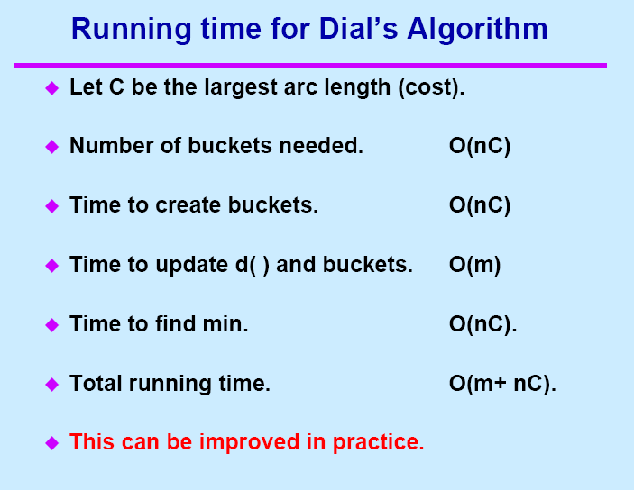

Slide 51
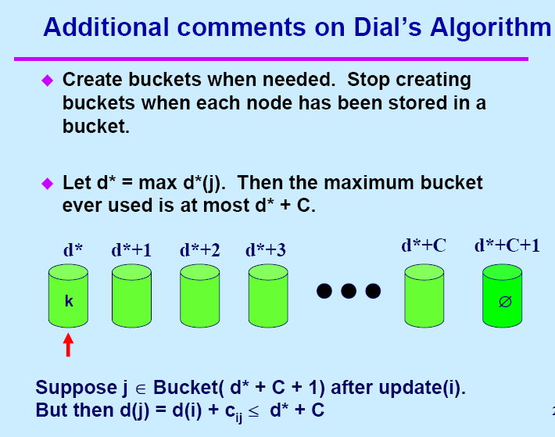

Slide 52
Implementations
With min-priority queue, Dijkstra algorithm can be
implemented in time
With Fibonacci heap, Dijkstra algorithm can be implemented
in time
With Radix heap, Dijkstra algorithm can be implemented
in time

Slide 53
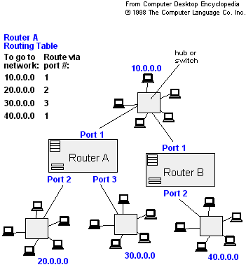
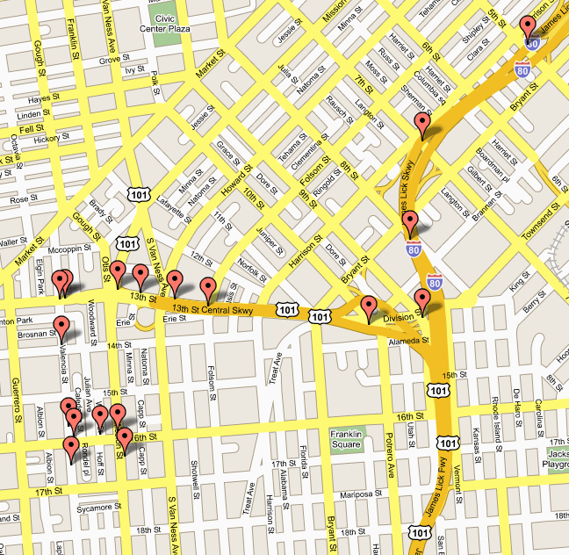
Applications of Dijkstra's Algorithm
- Traffic Information Systems are most prominent use
- Mapping (Map Quest, Google Maps)
- Routing Systems

Slide 54
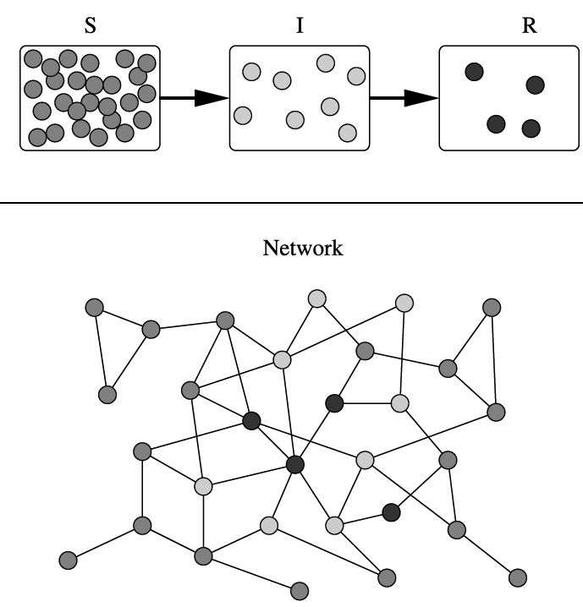
Applications of Dijkstra's Algorithm
One particularly relevant this week: epidemiology
Prof. Lauren Meyers (MIT, Biology Dept.) uses networks to model the spread of infectious diseases and design prevention and response strategies.
Vertices represent individuals, and edges their possible contacts. It is useful to calculate how a particular individual is connected to others.
Knowing the shortest path lengths to other individuals can be a relevant indicator of the potential of a particular individual to infect others.

Slide 55
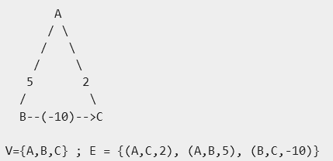
Question
Prove that, if there exists negative edge, dijkstra’s shortest path algorithm may fail to find the shortest path
In Dijkstra's algorithm, once a vertex is marked as "closed" (and out of the open set) - the algorithm found the shortest path to it, and will never have to develop this node again - it assumes the path developed to this path is the shortest.
But with negative weights
it might not be true.
For example: Dijkstra from
A will first develop C,
and will later fail to find
A->B->C

Slide 56
Question
Print the shortest path for dijkstra’s algorithm
void printD() {
int i;
for (i = 1; i <= n; ++i)
printf("%10d", i);
printf("\n");
for (i = 1; i <= n; ++i) {
printf("%10ld", d[i]);
}
printf("\n");
}

Slide 57
Assignment 3 (Due on next class)
How you can find number of shortest paths from source to destination using Dijkstra’s algorithm?
Suppose you are given a graph where each edge represents the path cost and each vertex has also a cost which represents that, if you select a path using this node, the cost will be added with the path cost. How can it be solved using Dijkstra’s algorithm?
How to solve ACM534 – Frogger?

